Slide 1
WELCOME! ☺
CUPE LOCAL 3651

Slide 2

WHO ARE WE?
CUPE (Canadian Union of Public Employees)
Canada’s Largest union, with other 740,000 members across the country
CUPE → Represents workers across a broad range of sectors including Health Care, Emergency Services, Education, Early Learning and Childcare, Municipalities, Social Services, Libraries, Utilities, Transportation and Airlines.

Slide 3

WHAT DO WE DO?
Advocates for workers who deliver the public services people depend on.
Helps members provide the highest level of service by ensuring they are safe and healthy at work, and that they get fair pay and benefits for the ervivces they provide.
Also advocates for better public services, like improvements to public health care and to the Canada Pension Plan, that would improve our communities and the lives of all Canadians.

Slide 4


CUPE COMMITEES
CUPE NATIONAL
CUPE ONTARIO

Slide 5

MEET YOUR LEADERS

Slide 6
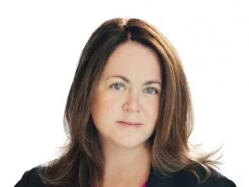

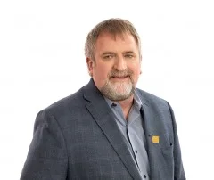
CUPE NATIONAL
The National Executive Board makes decisions on behalf of CUPE members in between conventions. Its members are elected
By CUPE members at CUPE’s Biennial National Conventions.
MARK HANCOCK
National President
CANDACE RENNICK
National Secretary Treasurer
FRED HAHN
General Vice-President
Ontario

Slide 7
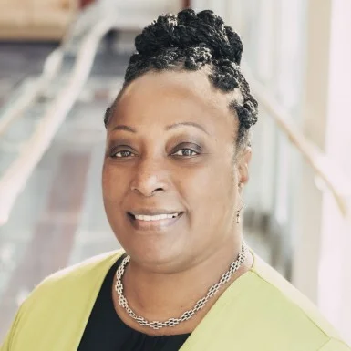
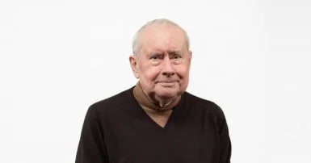


YOLANDA MCCLEAN
Regional Vice-president
Ontario
MICHAEL HURLEY
Regional Vice-president
Ontario
&
OCHU President
BRYAN KEITH
Regional Vice-president
Northern Ontario

Slide 8
GET TO KNOW YOUR LOCAL

Slide 9


News & upcoming events

Slide 10

CUPE 3651
Operates within 3 Collective Agreements:
  → Full Time Service
  → Part time Service
  → Clerical (Full Time & Part time)

Slide 11

Manned by your executive team and stewards

